Slide 1

American Express & University of Arizona Collaboration: Early-Legal Strategy
December 8, 2023

Slide 2
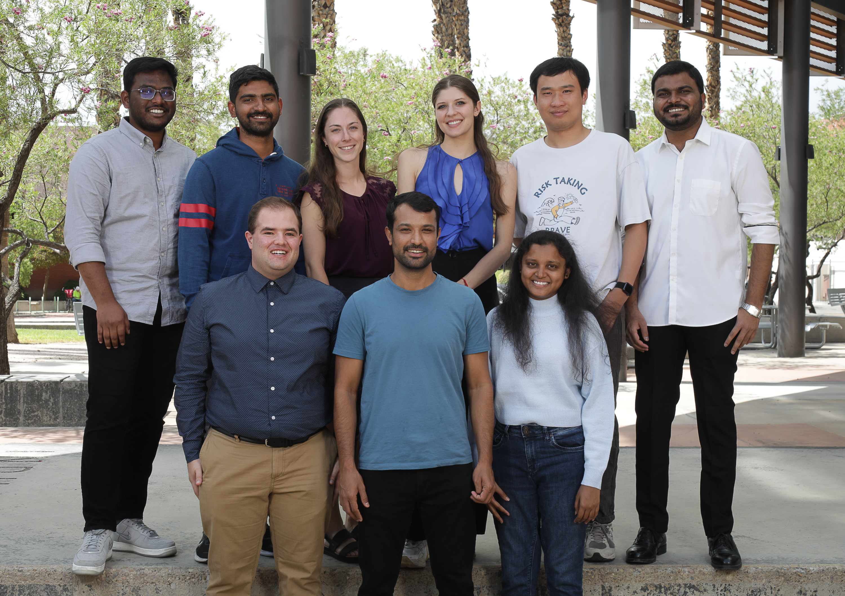
M.S. Students in Ag. & Resource Economics + 1
Left to Right, Top Row: Sai Chand Martha| Pavan Thodeti| Zoey Reed-Spitzer| Noëlle Bell| Ning Zhang| Chandrakant Agme| Left to Right, Bottom Row: Joe Bronstein| Keshav Bhusal| Sravani Sandhya Chokka. Missing: Jyothsna Atla| Paul Addison

Slide 3
Introduction & Business Problem
Zoey Reed-Spitzer

Slide 4
Business Problem
Analyze Early-Legal Strategy
Understand which aspects of cases explain whether cardmembers placed with collections attorney
Answer the business question…

Slide 5
Why do some cardmembers in this strategy work with AMEX while others take no action?
Does it have anything to do with:
Their spending habits or credit worthiness? Exposure? FICO?
Whether the cardmember is consumer or small business?
Having an email on file?
Their engagement on the phone (as RPC), over text, or with logins on MYCA website/MYCA Mobile app?

Slide 6
Agenda
Preview of Results: Case Characteristics & Engagement
Framework: Before and After Early Legal Letter Sent
Data Generating Process & Data Cleaning
Descriptive statistics
Results
Conclusion

Slide 7
Preview of Results: Case Characteristics
Joe Bronstein

Slide 8

Preview: Case Characteristics, Financial Indicators
FICO score is very important
Better FICO® Score ⇒ More likely to be not being placed
Both for Small Business and Consumer CM’s
Exposure is also a determining factor
Higher Exposure ⇒ higher likelihood of not being placed
We suspect cases with exposure ≥ $100k have higher Prob C scores.

Slide 9
Preview of Results: Engagement
H. Noëlle Bell

Slide 10







Preview: Significant Engagement Channels
Significant Channels
Channels Not Significant
MYCA Mobile Only
MYCA Only
Both MYCAs
Emails Sent
Inbound RPC
Chat
Text

Slide 11
Engagement Channels
Significant Channels
Emails Sent
Inbound RPC
The more, the better
Helps inform CM’s of account status
Inbound RPC → less likely to be placed with a collections attorney

Slide 12
Engagement Channels
Channels Not Significant
MYCA Mobile Only
Chat
MYCA Only
Text
Both MYCAs
Text capable CM’s no less likely to be placed with collections attorney
Effects of Chat and MYCA logins challenging to disentangle

Slide 13
Engagement Channels
Significant Channels
Quiz!
Which do you think has a greater impact?
Additional emails or inbound contact with a CM?

Slide 14
Engagement Channels
Significant Channels
Prior to sending an early legal letter, the more engagement, the better

Slide 15
Framework of Analysis: Before & After Early-Legal Letter
Paul Addison

Slide 16


Typical Case
Opens at 30 DPB
At 59 or 74 DPB, Cardmember is sent paper letter through USPS
CM is given 14 days to make a significant payment or enroll in FRP
Otherwise, placed with collections attorneys

Slide 17
Typical Case Timeline
59 or 74 DPB
14 Days
Case Open
Letter Sent
Evaluated for Placement

Slide 18
Typical Case Timeline
“Before”
“After”
Case Open
Letter Sent
Evaluated for Placement

Slide 19
Pros/Cons of Before/After Letter is Sent
Before
After
Pros
Provides actionable findings prior to letter being sent
Timeframe is more standard (59 or 74 DPB)
More variation in actions over 1 – 1 ½ months vs. 14 days
Cons
Less explanatory power
Pros
More explanatory power
Date of actions closer in time to outcome
Cons
Spurious correlation between actions and outcome.

Slide 20
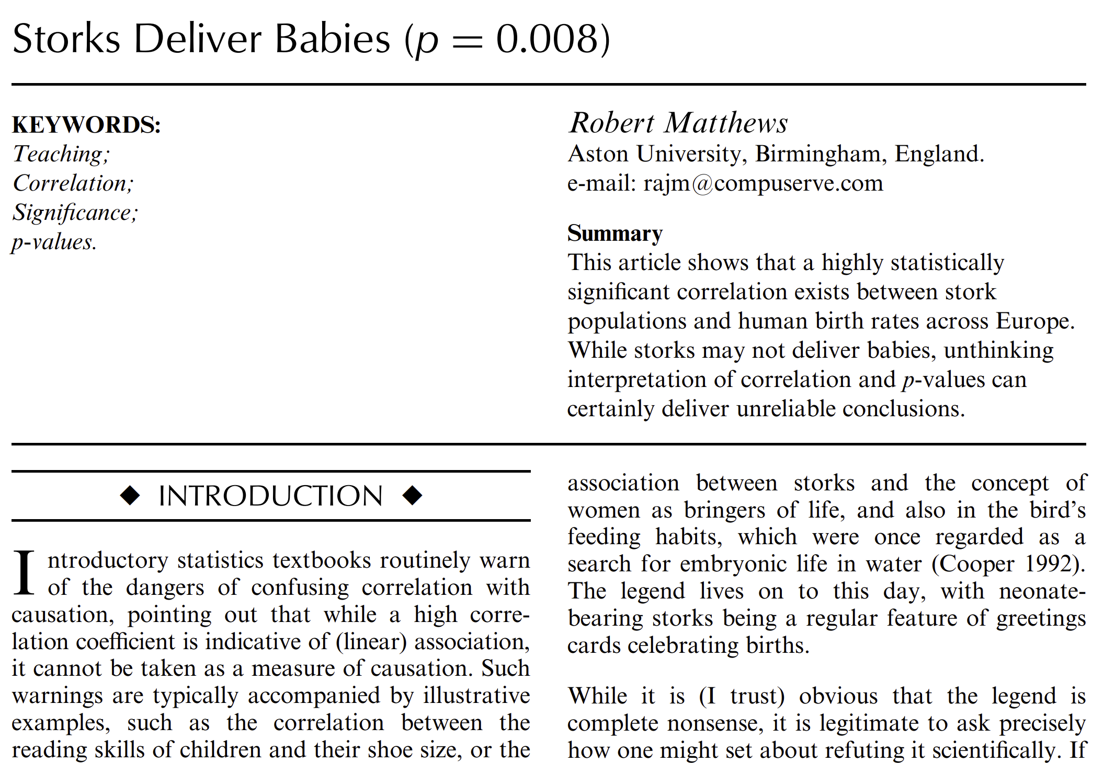
Correlation Does Not Imply Causation
Promise Kept after early-legal letter is sent = Not Placed

Slide 21
Framework of Analysis: Before & After Early-Legal Letter
Sai Chand Martha

Slide 22
Values of Case Characteristics & Engagement
“Before”
“After”
Case Open
Letter Sent
Evaluated for Placement
Case Characteristics: Product Type, Total Amount Due, Past Due, Exposure, FICO, CDSS
Engagement: Logins MYCA & MYCA Mobile, Email, SMS, Chat, RPC’s
Assumption: Behavior before is indicative of behavior after

Slide 23
Case Characteristics Fixed Over Time
4,784 Unique Cases
Few CM’s with Both Consumer & Small Business products
Cases with Both Products were included with Small Business because their case characteristics resembled those of Small Business cases

Slide 24
Case Characteristics Fixed Over Time
Lower percentage of Small Business cases placed
Small Business CM’s are 24.7% of total CM’s but account for 42.8% of Exposure ($60.2M of $140M)
Total Exposure, Million $
 | Consumer | Sm. Bus.
Placed | 69.4 | 44.2
Not Placed | 10.8 | 26.0
Total | 80.3 | 60.2

Slide 25
Case Characteristics Fixed Over Time
Lower percentage of Small Business cases placed
Small Business CM’s are 24.7% of total CM’s but account for 42.8% of Exposure ($60.2M of $140M)
Total Exposure, Million $
 | Consumer | Sm. Bus.
Placed | 69.4 | 44.2
Not Placed | 10.8 | 26.0
Total | 80.3 | 60.2

Slide 26

Data Cleaning & Management
Keshav Bhusal
WCC Data
Approach

Slide 27




Three Data Sets
WCC Data
Observations: 152.7M
Credit cases: 4.5 M
Period: Nov ‘12 – Sept ‘22
MYCA Web
Observations: 43.6 M
Credit cases: 1.9M
Period: Jan ‘22 – Sept ‘22
MYCA Mobile
Observations: 67.4 M
Credit cases: 2.7 M
Period: Jan ‘22 – Sept ‘22

Slide 28
Approach
Merging Datasets
Missing & Weird Values
Imputation
Last Observation Carried Forward
Median fills
Align &Truncate

Slide 29
Merging
MYCA Mobile
Observations: 67.4 M
Credit cases: 2.7 M
MYCA Web
Observations: 43.6 M
Credit cases: 1.9M
WCC Data
Observations: 152.7M
Credit cases: 4.5 M

Slide 30
Merging
MYCA MOBILE
Observations: 67.4 M
Credit cases: 2.7 M
MYCA WEB
Observations: 43.6 M
Credit cases: 1.9M
Intermediate Dataset
Observations: 861 K
Credit cases: 4,784
WCC Data
Observations: 152.7M
Credit cases: 4.5 M

Slide 31

Merging
MYCA Mobile
Observations: 67.4 M
Credit cases: 2.7 M
Roll Up
MYCA Web
Observations: 43.6 M
Credit cases: 1.9M
Intermediate Dataset
Observations: 861 K
Credit cases: 4,784
Final Dataset
N = 4,784
Jan 2022 – Sept 2022
WCC Data
Observations: 152.7M
Credit cases: 4.5 M

Slide 32
Missing and Weird Values
Last Observation Carried Forward (LOCF)
Variables
Total Case Amount Due
Total Past Due
Total Exposure
FICO Score
Setup CDSS
Case Close Date
Median
Credit Case with all observations missing
FICO score (Only 11 credit cases)
Data
Is the first observation missing?
YES
NO
Backward Imputation
Forward Imputation

Slide 33
pseudo_key | case_grp_cd | case_seq_nbr | act_dt | act_type_cd | Raw Exposure | Imputed Exposure | Type of Imputation
2088 | COMP | 2 | 09/10/2022 | RR | 62401.48 | 62401.48 | Forward Imputation
2088 | COMP | 2 | 09/10/2022 | RR | 62401.48 | 62401.48
2088 | COMP | 2 | 09/11/2022 | CP | NA | 62401.48
2088 | COMP | 2 | 09/11/2022 | RR | NA | 62401.48
5185 | COMP | 8 | 01/29/2022 | EN | NA | 12754.03 | Backward Imputation
5185 | COMP | 8 | 02/01/2022 | RR | NA | 12754.03
5185 | COMP | 8 | 02/01/2022 | AS | 12754.03 | 12754.03
5185 | COMP | 8 | 02/01/2022 | AS | 12754.03 | 12754.03
5185 | COMP | 8 | 02/04/2022 | PF | NA | 12754.03 | Forward Imputation
5185 | COMP | 8 | 02/04/2022 | PF | NA | 12754.03
5185 | COMP | 8 | 02/04/2022 | 1O | 12754.03 | 12754.03
5185 | COMP | 8 | 02/04/2022 | 1O | 12754.03 | 12754.03
NA
Missing Values

Slide 34
Vintage: Jan. 1 – Sept. 12, 2022
WCC Data
MYCA Web
Logins
MYCA Mobile
Logins
Earliest Open, Jan 1, 2022
Censored
Case Open
Early Legal Letter Sent
After August 29, 2022
Leaves Fewer than 14 Days
for Evaluation to Occur
Before EL
Latest EL Letter, Aug 29, 202
Early Legal Letter Sent
After EL
Evaluation for Placement
Latest Eval, Sept 12, 2022
Censored

Slide 35
Descriptive Statistics: Case Characteristics
Pavan Thodeti

Slide 36
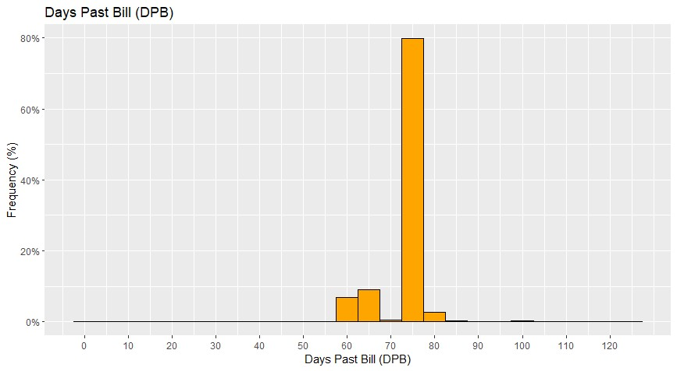
Days Past Bill at Early Legal

Slide 37
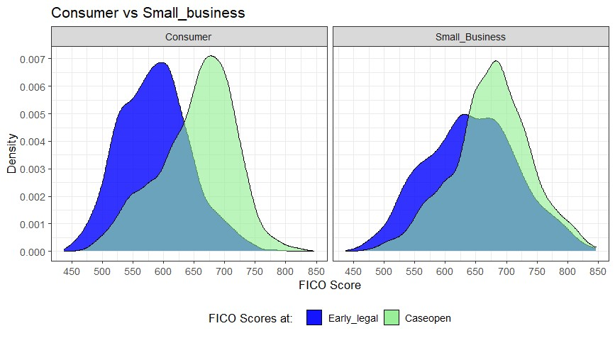
Declining FICO Scores, Case Open to Early Legal
Consumer vs. Small Business
Consumer vs. Small Business
676
587
Percentage
646
654
Mean Drop in FICO of 67 Points
Mean Drop in FICO of 30 Points
Early Legal
Case Open

Slide 38
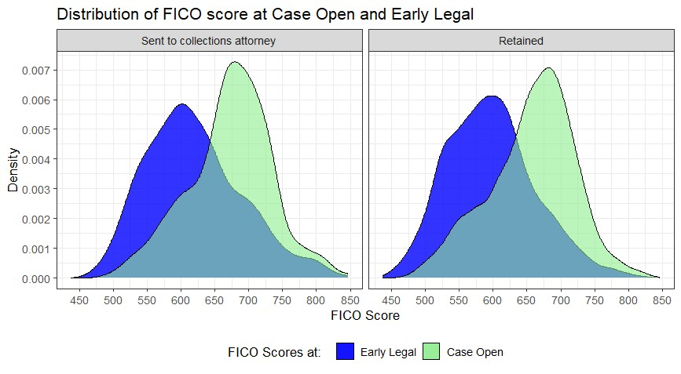
FICO Scores, Placed vs. Not Placed
Placed
Not Placed
Percentage
597
657
619
672
Mean Drop in FICO of 60 Points
Mean Drop in FICO of 53 Points

Slide 39
Percentage Not Placed by Exposure Buckets
39 Small Business CM’s
9 Consumer CM’s
Mean = 12.5%
Range
Percentile

Slide 40
Case Characteristics: Summary
98% of cases have early-legal letter sent either 59 or 74 DPB
FICO scores fall notably in the 30 to 45 days between case open and early legal.
Exposure in $100k + range associated with low percentage of placement

Slide 41
Descriptive Statistics: Engagement
Ning Zang

Slide 42
Engagement: Percentage of CM’s by Channel
Logins Before Early-Legal Letter Sent
Phone: Inbound vs. Outbound RPC
Valid SMS
Valid Email
Chat

Slide 43
Engagement: Percentage of CM’s by Channel
Logins Before Early-Legal Letter Sent
Phone: Inbound vs. Outbound RPC
Valid SMS
Valid Email
Chat
Quiz Time!

Slide 44
Logins: Logins Before Early-Legal Letter Sent
Fewer than 20% with Logins at MYCA or MYCA Mobile

Slide 45
Logins: Logins Before Early-Legal Letter, Small Bus. vs. Consumer
< ¼ with Logins at MYCA or MYCA Mobile
Consumer More Active on Mobile
Small Business More Active on Web & Both

Slide 46
Engagement: Communication Before Early-Legal Letter
Email Can Contain Link to Chat
2/3 CM’s with Valid Smart- Phone Number
Nearly all CM’s with Valid Email Address

Slide 47
Engagement by Channels Before Early-Legal Letter
Almost All Consumers have Valid Email
Almost 3/4 Consumers with Valid Smartphone Number
More Phone RPC’s for Small Business

Slide 48
Engagement: Emails Before Early-Legal Letter
92.3% of CM’s with Valid Emails
Mean # of Emails = 5.1
Maximum # of Emails = 36
Calculated Average Daily Number of Emails to Compare Different Days Past Bill Before Early Legal Across CM’s (Mean < 1 per week)

Slide 49
Engagement: Summary
Small proportion of CM’s logging in on MYCA & MYCA Mobile (< 20%)
Vast majority have valid emails.
¾ Consumers with valid smartphone number
Inbound/Outbound phone RPC’s higher for Small Business (16 - 17%)
Chat is minimal (< 5%)

Slide 50
Logistic Regression Results: FICO
Jyothsna Atla

Slide 51
Logistic Results: FICO Bins
FICO Bins | Consumer | Small Business | All
400-450 | -0.0216 | -0.0217 | -0.021
450-500 | 0.0037 | 0.0053 | 0.0041
500-550 | 0.0051 | 0.0055 | 0.0053
550-600 | 0.0048 | 0.0058 | 0.0051
600-650 | 0.0049 | 0.0047 | 0.0050
650-700 | 0.0044 | 0.0046 | 0.0046
700-750 | 0.0045 | 0.0047 | 0.0047
750-800 | 0.0055 | 0.0048 | 0.0049
800-850 | -0.012 | 0.0044 | 0.0043
Significant Impact

Slide 52
FICO: Summary
Higher scores above 700 lower probability of placement
Every increase of 10 FICO points raises likelihood of not being placed by ( 10 x 0.005 = 0.05).
Modest impact but not zero.

Slide 53
Logistic Regression Results: Exposure & Engagement
Sravani Chokka

Slide 54
Logistic Results: Exposure & Channels
Characteristic/Channel | Effect
Exposure, Small Business | 0.0029
Exposure, Consumer | 0.0041
Was there an Inbound Phone RPC | 0.380
Average Number of Daily Emails | 1.363
Surprise to us: Big email impact even though not part of early-Legal strategy

Slide 55
Conclusions & Possible Actionable Items
Chandrakant Agme

Slide 56
Summary
Starting: 153 million observations on 4.5 million card members
Business Question: what attributes before and after the early-legal letter is sent can explain the placement with collections attorney
The path: 4,784 unique cases early-legal letter sent

Slide 57
Trio of Results (Before Early Legal)
Higher FICO score ⇒ less likely to be placed
- for Consumers
- for Small Business
Inbound right-party contact
↑ Average daily count emails

Slide 58
Actionable Items
FICO Cutoff: > 700, more lenient treatment
> 14 days to evaluate placement
Kinder messaging initially graduating to more menacing later
Incorporate email into early-legal strategy
Nudges for inbound right-party contact
Warning about damage to FICO score if no action
Extend (Prob C thresholds + $100k) to lower exposure, say, $75k

Slide 59
Thank you!
Questions? Comments?

